Slide 1
Covid Tracker
Designing

Slide 2
First work
Set Color value for whole app
Set themes
Set Strings
App icon

Slide 3
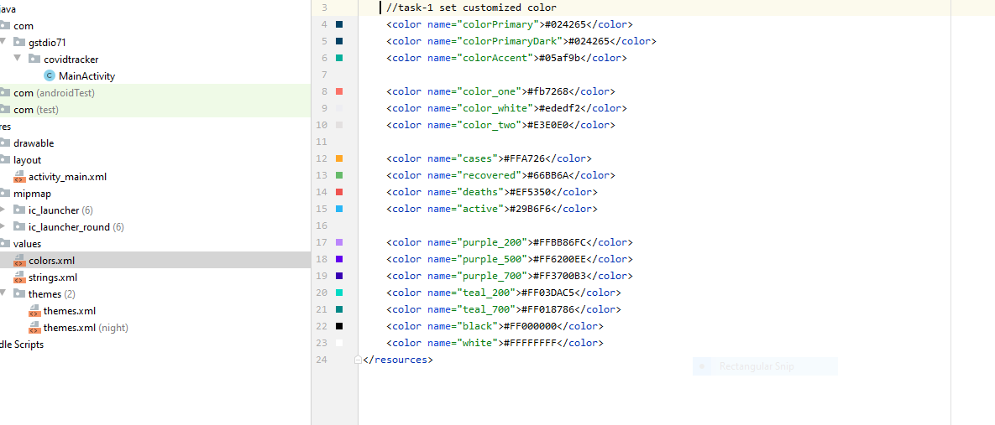
Set Color value for whole app

Slide 4
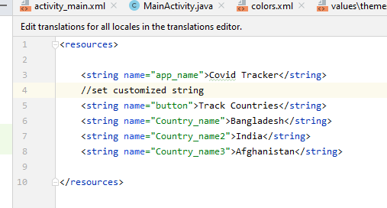
Set String

Slide 5
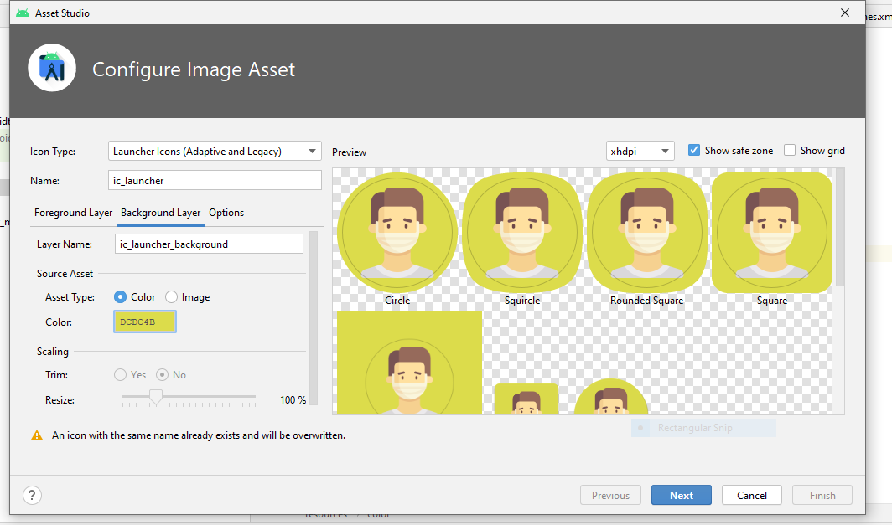
Set app icon

Slide 6
Dependency
Build.gradle
manifest

Slide 7
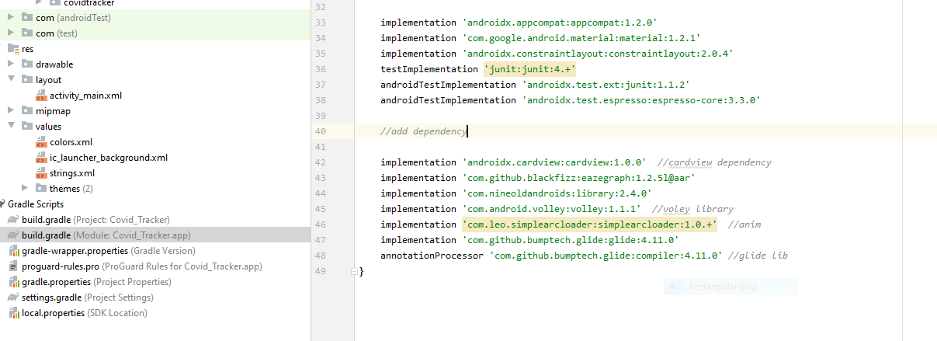
Dependency

Slide 8
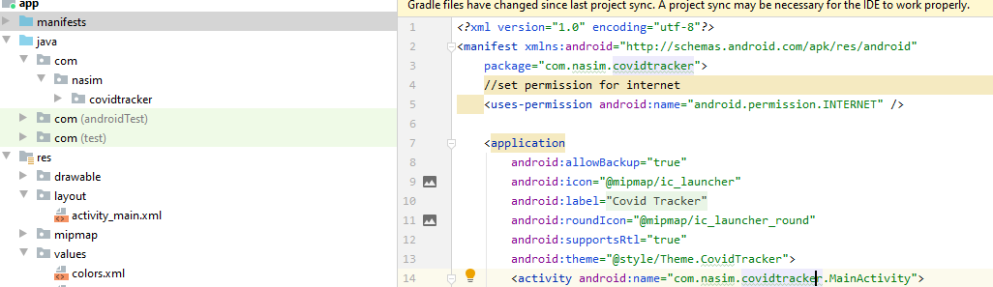
Permission

